Slide 1
Chapter 8 File Organization and Indexing
8.1 Disk and Storage
8.2 Organization of records into block
8.3 File Organization
8.4 B+ Tree index
8.5 Hash Index

Slide 2
8.1 Disk and Storage
Databases are stored in file formats, which contains records.
At physical level, actual data is stored in electromagnetic format on some device capable of storing it for a longer amount of time.
Several types of data storage exist in most computer systems. Among the media typically available are these:
Cache.
Main memory.
Flash memory
Magnetic-disk storage.
Optical storage.
Tape storage.
Write about each storage(Assignment)

Slide 3

8.1 Disk and Storage

Slide 4
8.2 Organization of records into block
A user can store the data in files in an organized manner.
These files are organized logically as a sequence of records and reside permanently on disks.
Each file is divided into fixed-length storage units known as Blocks.
These blocks are the units of storage allocation as well as data transfer.
Although the default block size in the database is 4 to 8 kilobytes, many databases allow specifying the size at the time of creating the database instance.

Slide 5
8.2 Organization of records into block
Usually, the record size is smaller than the block size.
But, for large data items such as images, the size can vary.
For accessing the data quickly, it is required that one complete record should reside in one block only.
It should not be partially divided between one or two blocks.
In RDBMS, the size of tuples varies in different relations.
Thus, we need to structure our files in multiple lengths for implementing the records.

Slide 6
8.2 Organization of records into block
In file organization, there are two possible ways of representing the records:
Fixed-length records
Variable-length records

Slide 7
8.2 Organization of records into block
Fixed length Records
Fixed-length records means setting a length and storing the records into the file.
If the record size exceeds the fixed size, it gets divided into more than one block.
Due to the fixed size there occurs following two problems:
Partially storing subparts of the record in more than one block requires access to all the blocks containing the subparts to read or write in it.
It is difficult to delete a record in such a file organization. It is because if the size of the existing record is smaller than the block size, then another record or a part fills up the block.

Slide 8
8.2 Organization of records into block
Fixed length Records
However, including a certain number of bytes is the solution to the above problems.
It is known as File Header. The allocated file header carries a variety of information about the file, such as the address of the first record.
The address of the second record gets stored in the first record and so on. This process is similar to pointers.
The method of insertion and deletion is easy in fixed-length records because the space left or freed by the deleted record is exactly similar to the space required to insert the new records.
But this process fails for storing the records of variable lengths.

Slide 9
8.2 Organization of records into block
Variable length Records
Variable-length records are the records that vary in size.
It requires the creation of multiple blocks of multiple sizes to store them.
These variable-length records are kept in the following ways in the database system:
Storage of multiple record types in a file.
It is kept as Record types that enable repeating fields like multisets or arrays.
It is kept as Record types that enable variable lengths either for one field or more.

Slide 10
8.2 Organization of records into block
Variable length Records
In variable-length records, there exist the following two problems:
Defining the way of representing a single record so as to extract the individual attributes easily.
Defining the way of storing variable-length records within a block so as to extract that record in a block easily.

Slide 11
8.2 Organization of records into block
Variable length Records
Thus, the representation of a variable-length record can be divided into two parts:
An initial part of the record with fixed-length attributes such as numeric values, dates, fixed-length character attributes for storing their value.
The data for variable-length attributes such as varchar type is represented in the initial part of the record by (offset, length) pair. The offset refers to the place where that record begins, and length refers to the length of the variable-size attribute. Thus, the initial part stores fixed-size information about each attribute, i.e., whether it is the fixed-length or variable-length attribute.

Slide 12
8.3 File Organization
File organization is a way of organizing the data in such way so that it is easier to insert, delete, modify and retrieve data from the files.
The method of mapping file records to disk blocks defines file organization, i.e. how the file records are organized.
File Organization refers to the logical relationships among various records that constitute the file, particularly with respect to the means of identification and access to any specific record.
In simple terms, Storing the files in a certain order is called File Organization.

Slide 13
8.3 File Organization
The Objective of File Organization
It helps in the faster selection of records i.e. it makes the process faster.
Different Operations like inserting, deleting, and update on different records are faster and easier.
It prevents us from inserting duplicate records via various operations.
It helps in storing the records or the data very efficiently at a minimal cost

Slide 14
8.3 File Organization
Types of File Organizations
Sequential File Organization
Heap File Organization
Hash File Organization
Clustered File Organization

Slide 15
8.3 File Organization
Sequential File Organization
The easiest method for file Organization is the Sequential method. In this method, the file is stored one after another in a sequential manner.
There are two ways to implement this method:
Pile File Method
Sorted File Method

Slide 16
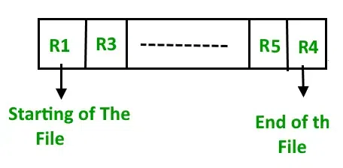
8.3 File Organization
Sequential File Organization
Pile File Method
This method is quite simple, in which we store the records in a sequence i.e. one after the other in the order in which they are inserted into the tables.

Slide 17
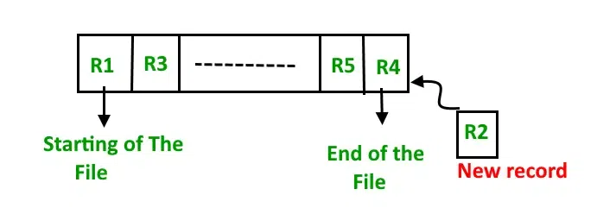
8.3 File Organization
Sequential File Organization
Pile File Method
Insertion of the new record: Let the R1, R3, and so on up to R5 and R4 be four records in the sequence. Here, records are nothing but a row in any table. Suppose a new record R2 has to be inserted in the sequence, then it is simply placed at the end of the file.

Slide 18
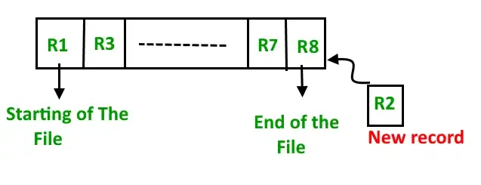
8.3 File Organization
Sequential File Organization
2. Sorted File Method
In this method, As the name itself suggests whenever a new record has to be inserted, it is always inserted in a sorted (ascending or descending) manner. The sorting of records may be based on any primary key or any other key.

Slide 19
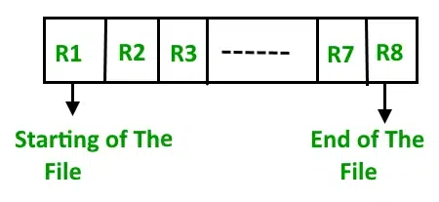
8.3 File Organization
Sequential File Organization
2. Sorted File Method
Insertion of the new record: Let us assume that there is a preexisting sorted sequence of four records R1, R3, and so on up to R7 and R8. Suppose a new record R2 has to be inserted in the sequence, then it will be inserted at the end of the file and then it will sort the sequence.

Slide 20
8.3 File Organization
Sequential File Organization
Advantages of Sequential File Organization
Fast and efficient method for huge amounts of data.
Simple design.
Files can be easily stored in magnetic tapes i.e. cheaper storage mechanism.

Slide 21
8.3 File Organization
Sequential File Organization
Disadvantages of Sequential File Organization
Time wastage as we cannot jump on a particular record that is required, but we have to move in a sequential manner which takes our time.
The sorted file method is inefficient as it takes time and space for sorting records.

Slide 22
8.3 File Organization
Heap File Organization
Heap File Organization works with data blocks. In this method, records are inserted at the end of the file, into the data blocks.
No Sorting or Ordering is required in this method.
If a data block is full, the new record is stored in some other block, Here the other data block need not be the very next data block, but it can be any block in the memory.
It is the responsibility of DBMS to store and manage the new records.

Slide 23
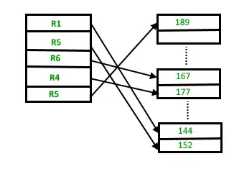
8.3 File Organization
Heap File Organization

Slide 24
8.3 File Organization
Heap File Organization
Insertion of the new record: Suppose we have four records in the heap R1, R5, R6, R4, and R3, and suppose a new record R2 has to be inserted in the heap then, since the last data block i.e data block 3 is full it will be inserted in any of the data blocks selected by the DBMS, let’s say data block 1.

Slide 25
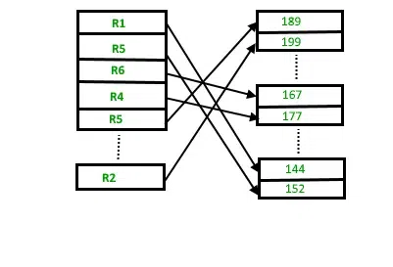
8.3 File Organization
Heap File Organization

Slide 26
8.3 File Organization
Heap File Organization
Advantages of Heap File Organization
Fetching and retrieving records is faster than sequential records but only in the case of small databases.
When there is a huge number of data that needs to be loaded into the database at a time, then this method of file Organization is best suited.
Disadvantages of Heap File Organization
The problem of unused memory blocks.
Inefficient for larger databases.

Slide 27
8.3 File Organization
Hash File Organization
In this method, hash function is used to compute the address of a data block in memory to store the record.
The hash function is applied on certain columns of the records, known as hash columns to compute the block address.
These columns/fields can either be key or non-key attributes.

Slide 28
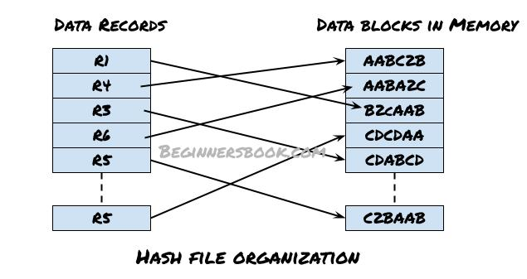
8.3 File Organization
Hash File Organization
In this method, hash function is used to compute the address of a data block in memory to store the record.

Slide 29
8.3 File Organization
Hash File Organization
These memory addresses are computed by applying hash function on certain attributes of these records.
Fetching a record is faster in this method as the record can be accessed using hash key column. No need to search through the entire file to fetch a record.

Slide 30
8.3 File Organization
Hash File Organization
Advantages of Hash File Organization
This method doesn’t require sorting explicitly as the records are automatically sorted in the memory based on hash keys.
Reading and fetching a record is faster compared to other methods as the hash key is used to quickly read and retrieve the data from database.
Records are not dependent on each other and are not stored in consecutive memory locations so that prevents the database from read, write, update, delete anomalies.

Slide 31
8.3 File Organization
Hash File Organization
Disadvantages of Hash File Organization
Can cause accidental deletion of data, if columns are not selected properly for hash function. For example, while deleting an Employee "Steve" using Employee_Name as hash column can cause accidental deletion of other employee records if the other employee name is also "Steve". This can be avoided by selecting the attributes properly, for example in this case combining age, department or SSN with the employee_name for hash key can be more accurate in finding the distinct record.
Memory is not efficiently used in hash file organization as records are not stored in consecutive memory locations.
If there are more than one hash columns, searching a record using a single attribute will not give accurate results.

Slide 32
8.3 File Organization
Cluster File Organization
Cluster file organization is different from the other file organization methods.
Other file organization methods mainly focus on organizing the records in a single file (table).
Cluster file organization is used, when we frequently need combined data from multiple tables.
While other file organization methods organize tables separately and combine the result based on the query, cluster file organization stores the combined data of two or more frequently joined tables in the same file known as cluster. This helps in accessing the data faster.

Slide 33
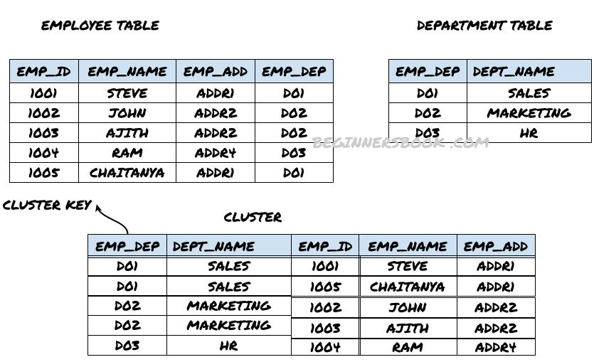
8.3 File Organization
Cluster File Organization

Slide 34
8.3 File Organization
Cluster File Organization
There are two types of cluster file organizations:
Index based cluster file organization
Hash based cluster file organization

Slide 35
8.3 File Organization
Cluster File Organization
Index based cluster file organization: The example that we have shown in the above diagram is an index based cluster file organization. In this type, the cluster is formed based on the cluster key and this cluster key works as an index of the cluster.
Since EMP_DEP field is common in both the tables, this becomes the cluster key when these two tables joined to form the cluster. Whenever we need to find the combined record of employees and department based on the EMP_DEP, this cluster can be used to quickly retrieve the data.

Slide 36
8.3 File Organization
Cluster File Organization
Hash based cluster file organization: This is same as index based cluster file organization except that in this type, the hash function is applied on the cluster key to generate the hash value and that value is used in the cluster instead of the index.
Note: The main difference between these two types is that in index based cluster, records are stored with cluster key while in hash based cluster, the records are stored with the hash value of the cluster key.

Slide 37
8.3 File Organization
Cluster File Organization
Advantages of cluster file organization
This method is popularly used when multiple tables needs to be joined frequently based on the same condition.
When a table in database is joined with multiple tables of the same database then cluster file organization method will be more efficient compared to other file organization methods.

Slide 38
8.3 File Organization
Cluster File Organization
Disadvantages of cluster file organization
Not suitable for large databases: This method is not suitable if the size of the database is huge as the performance of various operations on the data will be poor.
Not flexible with joining condition: This method is not suitable if the join condition of the tables keep changing, as it may take additional time to traverse the joined tables again for the new condition.
Isolated tables: If tables are not that related and there is rarely any join query on tables then using this file organization is not recommended. This is because maintaining the cluster for such tables will be useless when it is not used frequently.

Slide 39
8.4 Indexing
Indexing is used to optimize the performance of a database by minimizing the number of disk accesses required when a query is processed.
The index is a type of data structure. It is used to locate and access the data in a database table quickly.
Indexes can be created using some database columns.

Slide 40
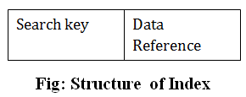
8.4 Indexing
Index structure:
The first column of the database is the search key that contains a copy of the primary key or candidate key of the table. The values of the primary key are stored in sorted order so that the corresponding data can be accessed easily.
The second column of the database is the data reference. It contains a set of pointers holding the address of the disk block where the value of the particular key can be found.

Slide 41
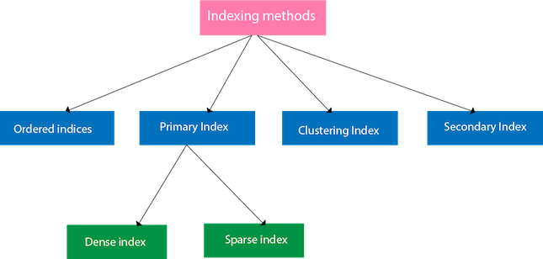
8.4 Indexing
Types of indexing

Slide 42
8.4 Indexing
Ordered indices
The indices are usually sorted to make searching faster. The indices which are sorted are known as ordered indices.
Example: Suppose we have an employee table with thousands of record and each of which is 10 bytes long. If their IDs start with 1, 2, 3....and so on and we have to search student with ID-543.
In the case of a database with no index, we have to search the disk block from starting till it reaches 543. The DBMS will read the record after reading 543*10=5430 bytes.
In the case of an index, we will search using indexes and the DBMS will read the record after reading 542*2= 1084 bytes which are very less compared to the previous case.

Slide 43
8.4 Indexing
Primary index
If the index is created on the basis of the primary key of the table, then it is known as primary indexing.
These primary keys are unique to each record and contain 1:1 relation between the records.
As primary keys are stored in sorted order, the performance of the searching operation is quite efficient.
The primary index can be classified into two types:
Dense index
Sparse index

Slide 44
8.4 Indexing
Dense index
The dense index contains an index record for every search key value in the data file. It makes searching faster.
In this, the number of records in the index table is same as the number of records in the main table.
It needs more space to store index record itself.
The index records have the search key and a pointer to the actual record on the disk.

Slide 45
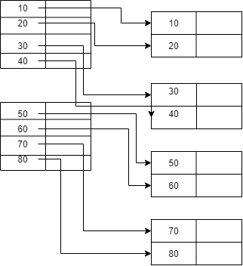
8.4 Indexing
Dense index

Slide 46
8.4 Indexing
Sparse index
Only a few of the data file's items-each of which points to a block-have an index record.
Instead of pointing to every record in the main database, the index in sparse indexing only points to the entries in the gap.

Slide 47
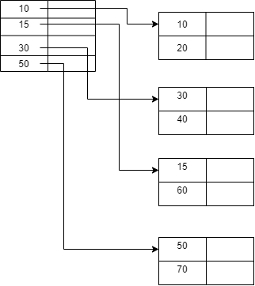
8.4 Indexing
Sparse index

Slide 48
8.4 Indexing
Clustering index
A clustered index can be defined as an ordered data file. Sometimes the index is created on non-primary key columns which may not be unique for each record.
In this case, to identify the record faster, we will group two or more columns to get the unique value and create index out of them. This method is called a clustering index.
The records which have similar characteristics are grouped, and indexes are created for these group.

Slide 49
8.4 Indexing
Clustering index
Example: suppose a company contains several employees in each department. Suppose we use a clustering index, where all employees which belong to the same Dept_ID are considered within a single cluster, and index pointers point to the cluster as a whole. Here Dept_Id is a non-unique key.

Slide 50
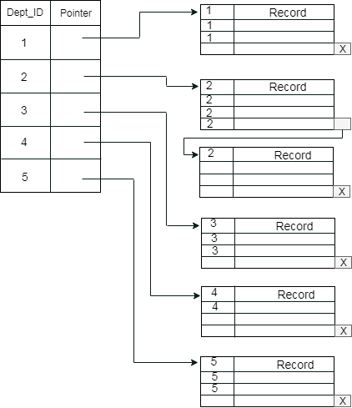
8.4 Indexing
Clustering index

Slide 51
8.4 Indexing
Secondary index
In the sparse indexing, as the size of the table grows, the size of mapping also grows.
These mappings are usually kept in the primary memory so that address fetch should be faster.
Then the secondary memory searches the actual data based on the address got from mapping.
If the mapping size grows then fetching the address itself becomes slower.
In this case, the sparse index will not be efficient. To overcome this problem, secondary indexing is introduced.

Slide 52
8.4 Indexing
Secondary index
In secondary indexing, to reduce the size of mapping, another level of indexing is introduced.
In this method, the huge range for the columns is selected initially so that the mapping size of the first level becomes small.
Then each range is further divided into smaller ranges.
The mapping of the first level is stored in the primary memory, so that address fetch is faster.
The mapping of the second level and actual data are stored in the secondary memory (hard disk).

Slide 53
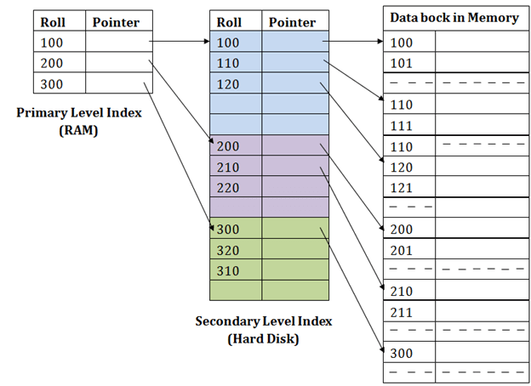
8.4 Indexing
Secondary index

Slide 54
8.4 Indexing
Secondary index
For example:
If you want to find the record of roll 111 in the diagram, then it will search the highest entry which is smaller than or equal to 111 in the first level index. It will get 100 at this level.
Then in the second index level, again it does max (111) <= 111 and gets 110. Now using the address 110, it goes to the data block and starts searching each record till it gets 111.
This is how a search is performed in this method. Inserting, updating or deleting is also done in the same manner.

Slide 55
8.4 Indexing
Multilevel index
In this method, we can see that index mapping growth is reduced to considerable amount.
But this method can also have same problem as the table size increases.
In order to overcome this, we can introduce multiple levels between primary memory and secondary memory.
In this method number of secondary level index is two or more.

Slide 56
8.4 Indexing
B+ index
The B+ tree is a balanced binary search tree. It follows a multi-level index format.
In the B+ tree, leaf nodes denote actual data pointers. B+ tree ensures that all leaf nodes remain at the same height.
In the B+ tree, the leaf nodes are linked using a link list. Therefore, a B+ tree can support random access as well as sequential access.

Slide 57
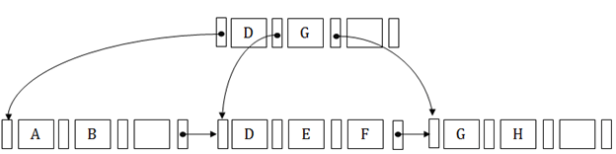
8.4 Indexing
B+ index
Structure of B+ Tree
In the B+ tree, every leaf node is at equal distance from the root node. The B+ tree is of the order n where n is fixed for every B+ tree.
It contains an internal node and leaf node.

Slide 58
8.4 Indexing
B+ index
Structure of B+ Tree
Internal node
An internal node of the B+ tree can contain at least n/2 record pointers except the root node.
At most, an internal node of the tree contains n pointers.
Leaf node
The leaf node of the B+ tree can contain at least n/2 record pointers and n/2 key values.
At most, a leaf node contains n record pointer and n key values.
Every leaf node of the B+ tree contains one block pointer P to point to next leaf node.

Slide 59
8.4 Indexing
B+ index Insertion
Suppose we want to insert a record 60 in the below structure. It will go to the 3rd leaf node after 55. It is a balanced tree, and a leaf node of this tree is already full, so we cannot insert 60 there.
In this case, we have to split the leaf node, so that it can be inserted into tree without affecting the fill factor, balance and order.

Slide 60
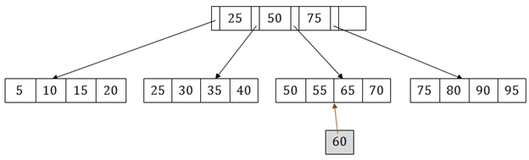
8.4 Indexing
B+ index Insertion
The 3rd leaf node has the values (50, 55, 60, 65, 70) and its current root node is 50. We will split the leaf node of the tree in the middle so that its balance is not altered. So we can group (50, 55) and (60, 65, 70) into 2 leaf nodes.

Slide 61
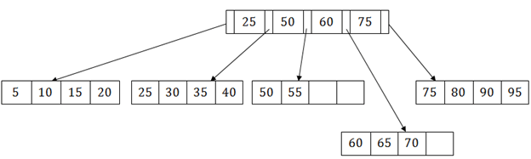
8.4 Indexing
B+ index Insertion
If these two has to be leaf nodes, the intermediate node cannot branch from 50. It should have 60 added to it, and then we can have pointers to a new leaf node.

Slide 62
8.4 Indexing
Hash index
Hashing technique is used to calculate the direct location of a data record on the disk without using index structure.
In this technique, data is stored at the data blocks whose address is generated by using the hashing function.
The memory location where these records are stored is known as data bucket or data blocks.

Slide 63
8.4 Indexing
Hash index
In this, a hash function can choose any of the column value to generate the address.
Most of the time, the hash function uses the primary key to generate the address of the data block.
A hash function is a simple mathematical function to any complex mathematical function.
We can even consider the primary key itself as the address of the data block. That means each row whose address will be the same as a primary key stored in the data block.

Slide 64
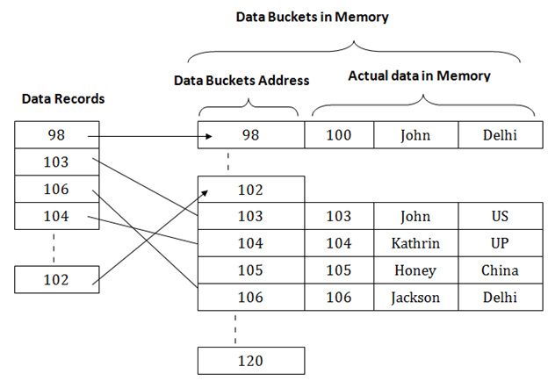
8.4 Indexing
Hash index

Slide 65
8.4 Indexing
Hash index
The above diagram shows data block addresses same as primary key value.
This hash function can also be a simple mathematical function like exponential, mod, cos, sin, etc.
Suppose we have mod (5) hash function to determine the address of the data block. I
n this case, it applies mod (5) hash function on the primary keys and generates 3, 3, 1, 4 and 2 respectively, and records are stored in those data block addresses.

Slide 66
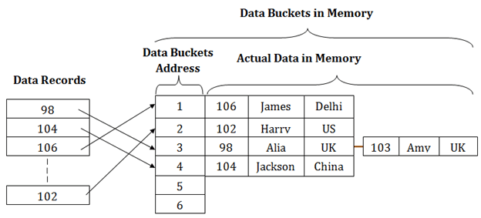
8.4 Indexing
Hash index

Slide 67
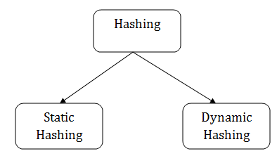
8.4 Indexing
Hash index
Types of Hashing:

Slide 68
8.4 Indexing
Indexed sequential access method (ISAM)
ISAM method is an advanced sequential file organization.
In this method, records are stored in the file using the primary key.
An index value is generated for each primary key and mapped with the record. This index contains the address of the record in the file.
If any record has to be retrieved based on its index value, then the address of the data block is fetched and the record is retrieved from the memory.

Slide 69
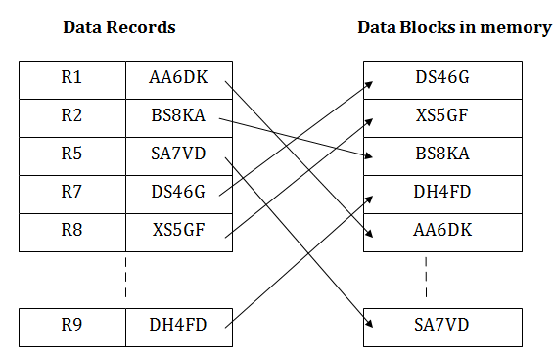
8.4 Indexing
Indexed sequential access method (ISAM)

Slide 70
8.4 Indexing
Indexed sequential access method (ISAM)
Pros of ISAM:
In this method, each record has the address of its data block, searching a record in a huge database is quick and easy.
This method supports range retrieval and partial retrieval of records. Since the index is based on the primary key values, we can retrieve the data for the given range of value. In the same way, the partial value can also be easily searched, i.e., the student name starting with 'JA' can be easily searched.

Slide 71
8.4 Indexing
Indexed sequential access method (ISAM)
Cons of ISAM:
This method requires extra space in the disk to store the index value.
When the new records are inserted, then these files have to be reconstructed to maintain the sequence.
When the record is deleted, then the space used by it needs to be released. Otherwise, the performance of the database will slow down.

Slide 72
Assignment
Types of Hashing
Advantages and Disadvantages Indexing
Non clustering Index

Slide 73
This is the end of the lecture!
I hope you enjoyed it.
Thank You

